Slide 1
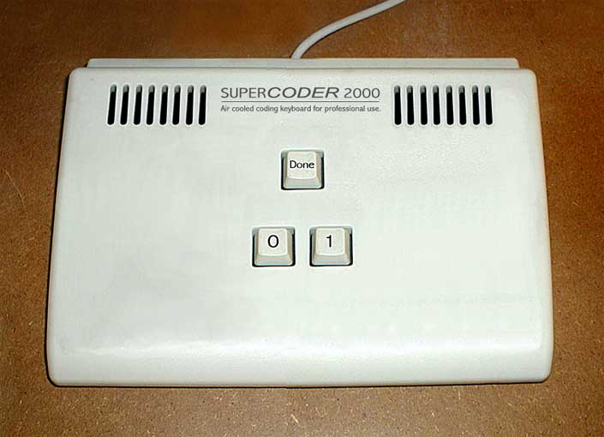
Binary Math and Boolean Logic
Programming – Math for Games

Slide 2
Contents
Number Systems
Binary Numbers
Binary Operations
Two’s Complement
Conversion Between Bases

Slide 3
Number Systems
The number system most frequently used in society is the decimal number system, also referred to as the base ten number system.
There are other number systems
Base 2 : Binary
Base 8 : Octal
Base 16 : Hexadecimal

Slide 4
Number Systems
Computer memory is made up of bits – binary digits – represented by the base 2 number system.
These can be hard for humans to understand – so we can use the other numbering systems to represent binary:
Base 8 : Octal
Base 10 : Decimal
Base 16 : Hexadecimal

Slide 5
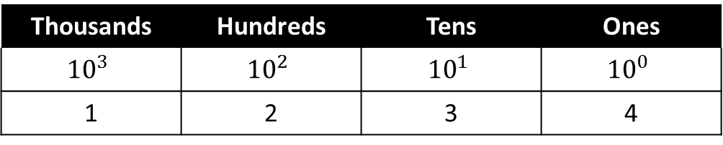

Common Theme
Numerals in these number systems are organised into columns.
Each column is the base number raised to a power, the far right column represents ${base}^{0}$.

Slide 6

Decimal – Base 10
Uses the numerals 0 - 9
If a numeral exceeds 9 in a given column that value will roll over to zero and one is added to the column to the immediate left.

Slide 7
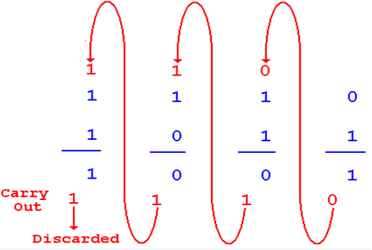
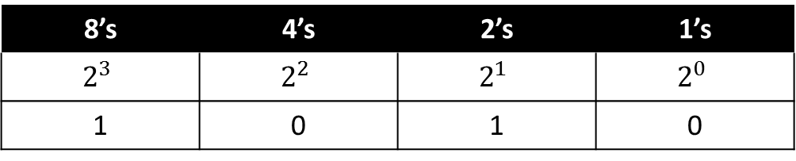
Binary – Base 2
Numerals 0 and 1
If a numeral exceeds one in a given column that value rolls over to zero, and one is added to the column to the left.

Slide 8
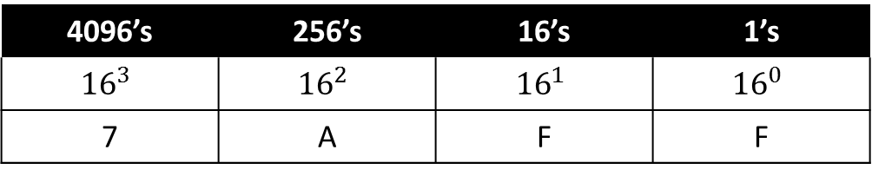
Hexadecimal – Base 16
Numerals 0 – 9 then A, B, C, D, E, F
If a numeral exceeds nine then letters are used
If a numeral exceeds F in a given in a given column that value rolls over to zero, and one is added to the column to the left

Slide 9
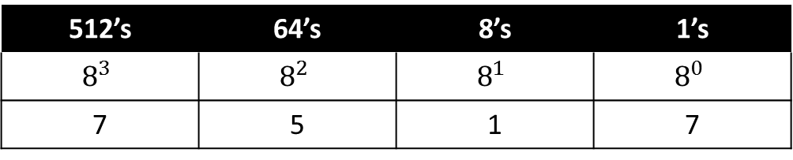
Base 8
Numerals 0 - 8
If a numeral exceeds seven in a given column that value rolls over to zero, and one is added to the column to the left

Slide 10
Conversion Between Bases
We can manually convert between the different bases using some simple maths
Decimal -> Binary
Binary -> Decimal
Binary -> Hex

Slide 11
Decimal -> Binary
There are two main methods to convert from Decimal to Binary:
Short division by two with remainder
Comparing powers of two and subtraction

Slide 12
Decimal -> Binary (Divide by two method)
Take the number we need to convert.
Divide it by two.
Note down the remainder (0 or 1).
Take the result from 2 and repeat steps 2 and 3 until the result is one or zero.
The remainders when read backwards form the binary number.

Slide 13
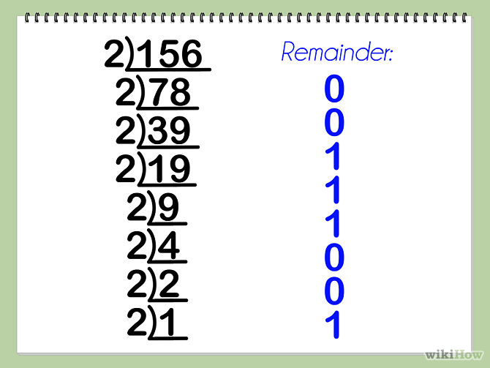
Decimal -> Binary (divide by two method)
In this case the number is: 1001 1100

Slide 14
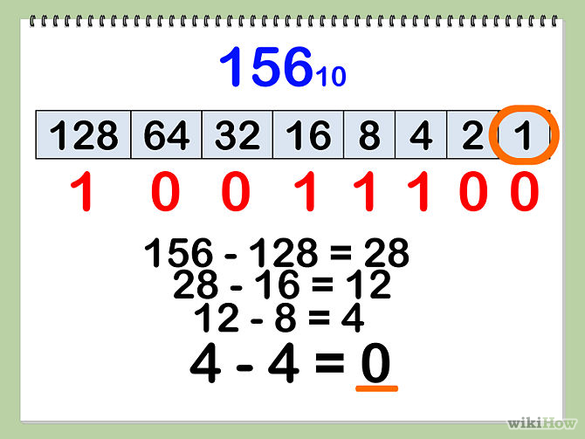
Decimal->Binary (Powers of two)

Slide 15
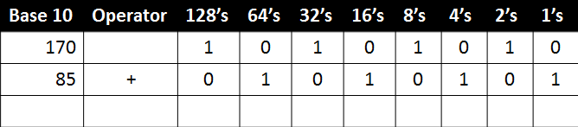
Different Base, Same Math
Mathematical operators applied to decimal numbers can also be applied to binary numbers:

Slide 16
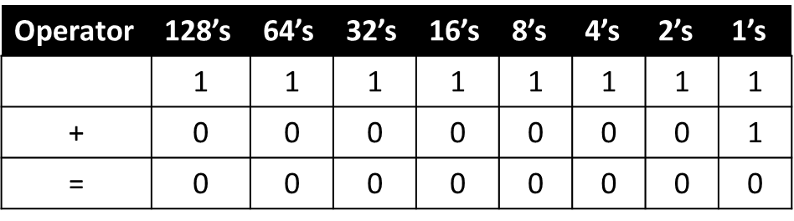
Truncation
Consider the value 255 from the previous slide. If 1 is added to it a chain reaction of carries occurs.
All bits flip and 1 is carried to the left and lost.
The number that was meant to be 256 is now zero.
Notes:
Example: In the original Pokemon games – upon levelling up to a level 255, it would return to level 0. Obviously only a single byte was used to store the information about the level of each Pokemon
What happens if we subtract 1 from 0?

Slide 17
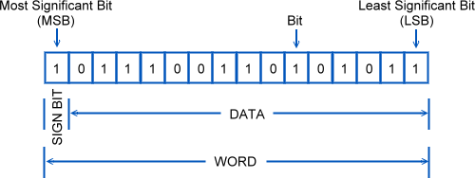
Negative Binary Numbers
So far all the binary numbers we’ve looked at have been positive, or unsigned.
How do we represent negative numbers in binary?
Sign and Magnitude - the most significant bit (left-most) represents the sign on the number, leaving 15 bits (in an integer, for example) to store the magnitude. 1 for negative, and 0 for positive.

Slide 18
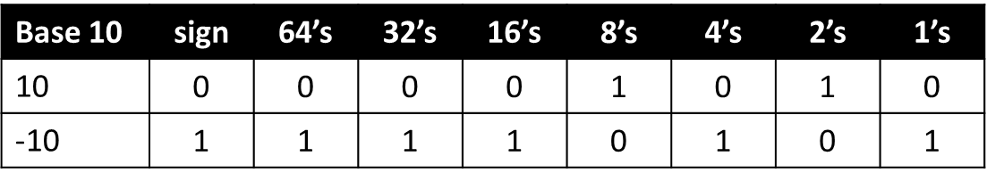
One’s Complement
A simple method to represent negative binary numbers.
Flip all the bits in a binary number – that’s it!

Slide 19
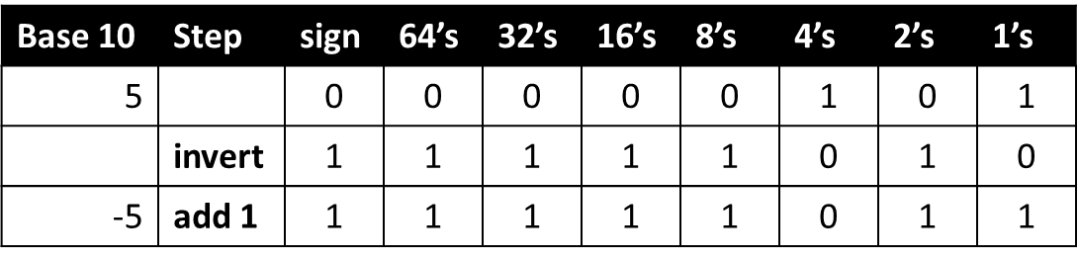
Two’s Complement
To represent negative values computers today use a two’s complement notation.
The two’s complement of a bit pattern is the inversion of all bits followed by the addition of one.

Slide 20
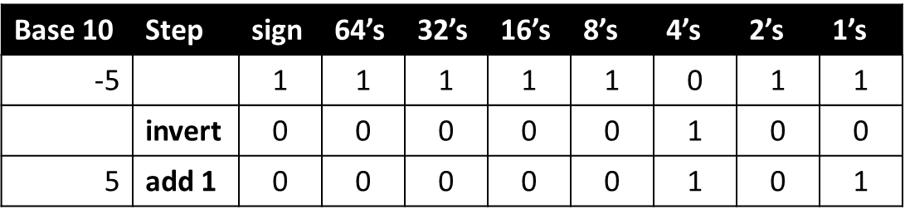
Two’s Complement
The most significant bit (MSB) is a sign bit.
If set the number is negative.
The reverse works in the same fashion.

Slide 21
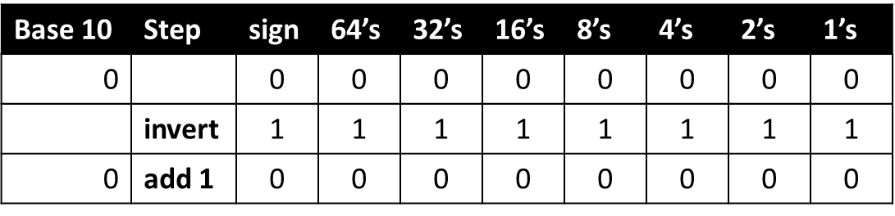
Two’s Complement Works With Zero
Consider the two’s complement of Zero:
The inversion sets all bits, the addition of one results in a truncation; which results in a value of zero

Slide 22
Bitwise Operators
Bitwise operators operate on integral types, treating them as a collection of bits
Operator | Function | Use
& | bitwise AND | operand & operand
| | bitwise OR | operand | operand
~ | bitwise NOT | ~operand
^ | bitwise XOR | operand ^ operand
<< | left shift | operand << operand
>> | right shift | operand >> operand
Notes:
There are additional operations that we can apply to integers that affect them at a binary level.
The first four are similar to logical operators you have seen before.

Slide 23
Bitwise AND
& compares two bits
Yields a value of 1 if both bits are set, 0 otherwise.
Base 10 | Operator | 128’s | 64’s | 32’s | 16’s | 8’s | 4’s | 2’s | 1’s
255 |  | 1 | 1 | 1 | 1 | 1 | 1 | 1 | 1
170 | & | 1 | 0 | 1 | 0 | 1 | 0 | 1 | 0
170 | = | 1 | 0 | 1 | 0 | 1 | 0 | 1 | 0
//What will be output by the following?
int result = 5 & 6;
std::cout << result << std::endl;
Notes:
Remember 1 is true, 0 is false. True AND True = True (1)
True AND False = False (0)
False AND False = False (0)
Answer: 4

Slide 24
Bitwise OR
| compares two bits
Yields a value of 1 if any bits are set, 0 otherwise.
Base 10 | Operator | 128’s | 64’s | 32’s | 16’s | 8’s | 4’s | 2’s | 1’s
204 |  | 1 | 1 | 0 | 0 | 1 | 1 | 0 | 0
170 | | | 1 | 0 | 1 | 0 | 1 | 0 | 1 | 0
238 | = | 1 | 1 | 1 | 0 | 1 | 1 | 1 | 0
//What will be output by the following?
int result = 5 | 6;
std::cout << result << std::endl;
Notes:
True OR True = True (1)
True OR False = True (1)
False OR False = False (0)
Answer: 7

Slide 25
Bitwise NOT
~ flips each bit
A value of 1 become a value of 0 and a value of 0 becomes a 1.
Base 10 | Operator | 128’s | 64’s | 32’s | 16’s | 8’s | 4’s | 2’s | 1’s
204 | ~ | 1 | 1 | 0 | 0 | 1 | 1 | 0 | 0
51 | = | 0 | 0 | 1 | 1 | 0 | 0 | 1 | 1
//What will be output by the following?
int result = ~6;
std::cout << result << std::endl;
Notes:
Same as ! Logical operator
Answer: -7 – you will probably need to explain this – remind about two’s complement

Slide 26
Bitwise XOR
^ (exclusive or) compares two bits
Yields a value of 1 if bits are different, 0 if same.
Base 10 | Operator | 128’s | 64’s | 32’s | 16’s | 8’s | 4’s | 2’s | 1’s
204 |  | 1 | 1 | 0 | 0 | 1 | 1 | 0 | 0
170 | ^ | 1 | 0 | 1 | 0 | 1 | 0 | 1 | 0
102 | = | 0 | 1 | 1 | 0 | 0 | 1 | 1 | 0
//What will be output by the following?
int result = 5 ^ 6;
std::cout << result << std::endl;
Notes:
This one is a bit different, but still easy to remember.
Answer: 3

Slide 27
Bitmasks
Bitmasks are used to perform a single bitwise operation on a set of bits. This is often used to represent multiple Boolean values.
We can use bitmasks to turn on or off various bits within a set of bits. Also to check the state of a bit within a set of bits.

Slide 28
Bitmasks reduce data storage
In Doom there were a limited number of weapons.
A player either has a weapon in their inventory or they don’t
We could use a boolean array to store this info
8 weapons * 1 (size of bool) = 8 bytes
Using a bitmask makes more sense
8 bits (one for each weapon) = 1 byte

Slide 29
Bit Shifting
The << and >> operators shift bits to the left or right, by a value given after the operator.
For example: 6 << 1
This means that the bits making up the number six will be shifted one space to the left
0000 0110 becomes 0000 1100 (12)
Notes:
No, these are not the stream insertion/extraction operators that you see with input/output. (Confusing, I know).
They are the bit shift operators. They move bits to the left or right. “New” bits are filled with zeros, and bits can get cut off *snicker*
NOTE: With >> replaces empty spots with a copy of the most significant bit (0 for positive numbers, 1 for negative)
Note that in this example the number is doubled. Ask what happens to the number if we shift right by 1.

Slide 30
Bit Shifting
Digits that are shifted off the end do not wrap around – they are lost
Operation | Result
1 << 6 | Shifts the value 1 six bits to the left, yields 64
66 >> 1 | Shifts the value 66 one bit to the right, yields 33
67 >> 1 | Shifts the value 67 one bit to the right, yields 33 due to truncation
Notes:
Show that 0000 0001 << 6 is 0100 0000 (64)
0100 0010 >> 1 is 0010 0001 (33)
0100 0011 >> 1 is 0010 0001 (33) last bit gets cut off
What happens if you shift the result of the last one << 1? Point out that we get 66 and not 67. Bits are not restored, they are lost and replaced with zero.

Slide 31
Shift Examples (continued)
Base 10 | Operation | 128’s | 64’s | 32’s | 16’s | 8’s | 4’s | 2’s | 1’s
1 | << 1 | 0 | 0 | 0 | 0 | 0 | 0 | 0 | 1
2 | = | 0 | 0 | 0 | 0 | 0 | 0 | 1 | 0
26 | << 4 | 0 | 0 | 0 | 1 | 1 | 0 | 1 | 0
160 | = | 1 | 0 | 1 | 0 | 0 | 0 | 0 | 0
160 | >> 7 | 1 | 0 | 1 | 0 | 0 | 0 | 0 | 0
1 | = | 0 | 0 | 0 | 0 | 0 | 0 | 0 | 1

Slide 32
Summary
Number systems you’ll commonly encounter are Binary and Hexadecimal
Number systems like hexadecimal make it easier to understand bits and bytes
When using bytes to represent numbers, if there aren’t enough bits the number will be truncated
For signed integers, the most significant bit represents the sign
Bitwise operators can be used to compare the value of bits
Bitmasks can be used to perform a single operation on a set of bits

Slide 33
Further Reading
C++ Primer 6th Edition : Appendix E
Article: Number Systems: An Introduction to Binary, Hexadecimal, and More http://code.tutsplus.com/tutorials/number-systems-an-introduction-to-binary-hexadecimal-and-more--active-10848

Slide 34
References
Stephen Prata, 2011. C++ Primer Plus (6th Edition) (Developer's Library). 6 Edition. Addison-Wesley Professional.

